Slide 1
ZyoFiSik
Your Personal AI trainer

Slide 2
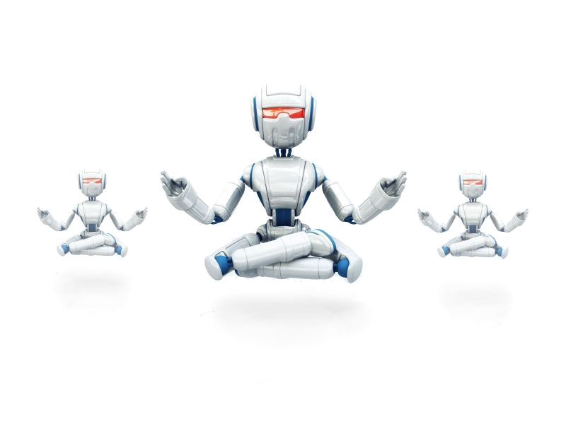
Domain - Artificial Intelligence

Slide 3
Co-ordinator &
Guide
Dr. L. Jaba Sheela
Angel F
211418104020
Team
ZyoFiSik
Bairavi B
211418104033
Jey Sneha A
211418104101

Slide 4
ZyoFiSik
YOGA ASSISTANT
PERSONAL TRAINER
FITNESS GUIDE
MEDITATION COACH

Slide 5
Abstract
While ensuring proper practice, Yoga learning and Self-instruction systems can popularize and disseminate Yoga.
These computerized Self-training systems for sports and fitness can improve participant performance and thwart injuries. Concocting an interactive web application that uses the webcam to recognize the user's yoga and exercise poses, and estimates each pose to assist the user practicing those postures and tracks successful shots at various stances.
Our approach seeks to recognize the yoga asanas based on the data attained by Data Collection from an open-source dataset where data collection is a real-time procedure that runs in tandem with keypoint detection.

Slide 6
The detected critical points are passed to our model where neural networks find patterns and Sequential model-CNN analyze their evolution over time.
Google's open-source Mediapipe framework is used in detecting the landmarks of the human body to retrieve the stick figure of the user for estimating their yoga poses and predict its accuracy by passing it to the CNN model.
On contrast in the curl counter, the angles made by the lines of the stick figure are used to calculate the degree or the angle made between the arm and the forearm which indeed helps in assisting the user as he or she can alter his or her posture accordingly.
Finally, the system contains a meditation coach which is programmed to give commands at standard intervals and subsequently, the user is ushered by a voice that instructs them to maintain their breathing pace thereby creating a soothing environment.

Slide 7
LANGUAGE - PYTHON
WEB FRAMEWORK - FLASK
Technology Stack
MACHINE LEARNING FRAMEWORK - MEDIAPIPE
NEURAL NETWORK - CNN
COMPUTER VISION LIBRARY - OPENCV
DEPLOYMENT PLATFORM - HEROKU

Slide 8
Modules
MILESTONE | MODULE | WEEK ( Completion )
1 | Meditation Coach | 1
2 | Curl Counter | 2
3 | Exercise Trainer | 3
4 | Yoga Assistant | 4
5 | Web Integration | 5
6 | Testing and Deployment | 6

Slide 9
Timeline Chart
Week 1
Week 2
Week 3
Week 4
Week 5
Week 6
Meditation Coach
Curl Counter
Exercise trainer
Yoga Assistant
Web Integration
Testing and deployment

Slide 10
Software
Development
Life
Cycle
ANALYSIS
DESIGN
CODE
TEST
MILESTONE 1
ANALYSIS
DESIGN
CODE
TEST
MILESTONE 2
ANALYSIS
DESIGN
CODE
TEST
MILESTONE 3
ANALYSIS
DESIGN
CODE
TEST
MILESTONE 4
ANALYSIS
DESIGN
CODE
TEST
MILESTONE 5
DEPLOY
TEST
INTEGRATE

Slide 11
List of references
BASE PAPER ⇒ Yash Agrawal, Yash Shah, and Abhishek Sharma, (2020), “Implementation of Machine Learning Technique for Identification of Yoga Poses”, 9th IEEE International Conference on Communication Systems and Network Technologies, pp. 40-43
DOI: 10.1109/CSNT48778.2020.9115758
Girija Gireesh Chiddarwar, Abhishek Ranjane, Mugdha Chindhe, Rachana Deodhar, and Palash Gangamwar, (2020), “AI-Based Yoga Pose Estimation for Android Application” International Journal of Innovative Science and Research Technology, Volume 5 - Issue 9
DOI: 10.38124/IJISRT20SEP704

Slide 12
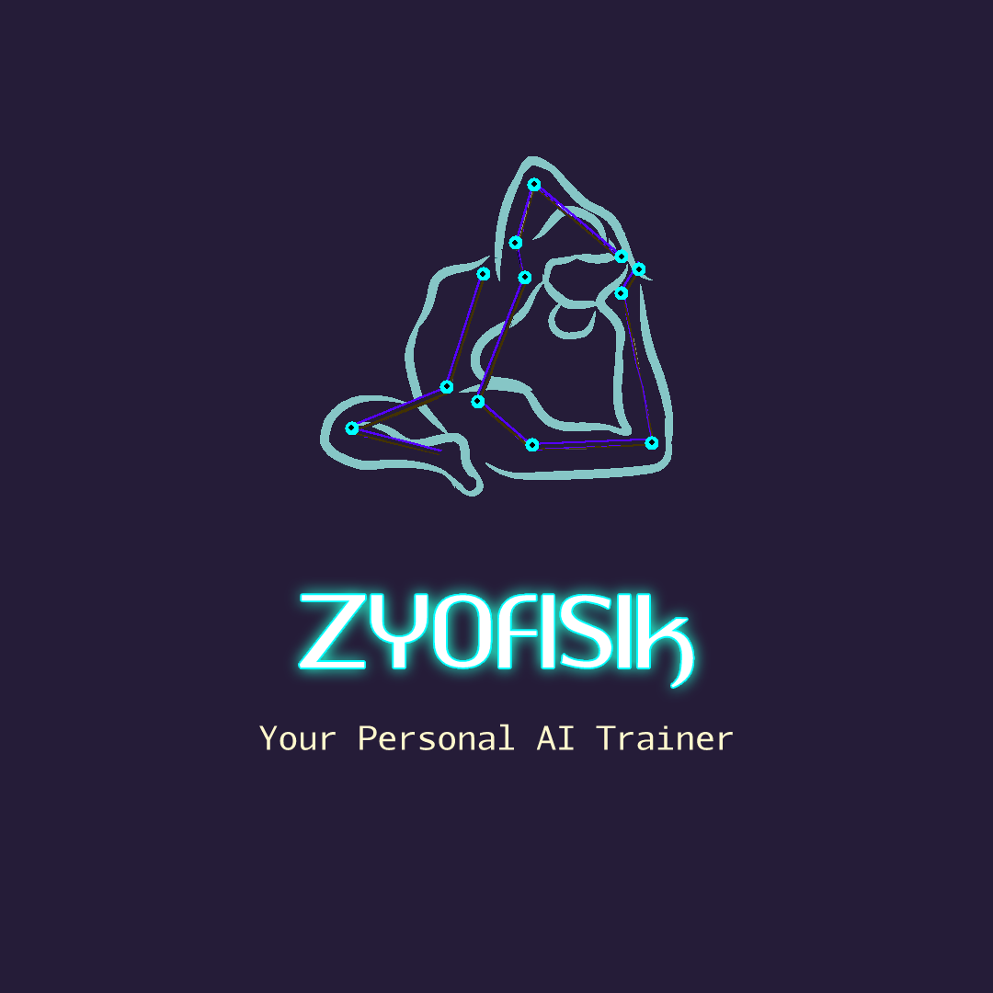

Slide 13

Thank You !!!
- ZyoFiSik

